Slide 1
Personalising this user guide for your organisation
This end user guide is intended as a guide for Kallidus customers to update according to their own internal processes. Please ensure that you read through it thoroughly and edit to suit your organisation and processes. The layout and design of this document has been deliberately kept plain and simple so that you are able to add your own branding or use PowerPoint design tools to add your preferred style.
Consider your audience – Would more detailed instructions or simplified instructions work better for them?
There may be functions described in the guide that you are not planning to use. Ensure that you delete them from the contents list and appropriate slides
Re-word and edit to suit your company tone of voice – including changing the term ‘Learn’ to the system name you will be using internally
Replace screenshots with imagery from your own system so that the branding and functions displayed match what your users will see. You may want to use a test user account with student only access for this.
Add your company logo and use your company branding, colours or standard layouts
When you are happy with the wording and layout of the guide, save it as a PDF to send out to your users as part of your communications. It can be added to Learn as a course for easy access, but be aware that it will likely need to be available outside of the system as well, so that your users have sight of how to locate the system and log in.
Anything highlighted in yellow will likely need to be deleted or replaced as appropriate
The FAQ/Contacts slide at the end of this document will need to be updating according to your organisational processes
Please remember to remove this slide before saving as PDF and providing to your users

Slide 2
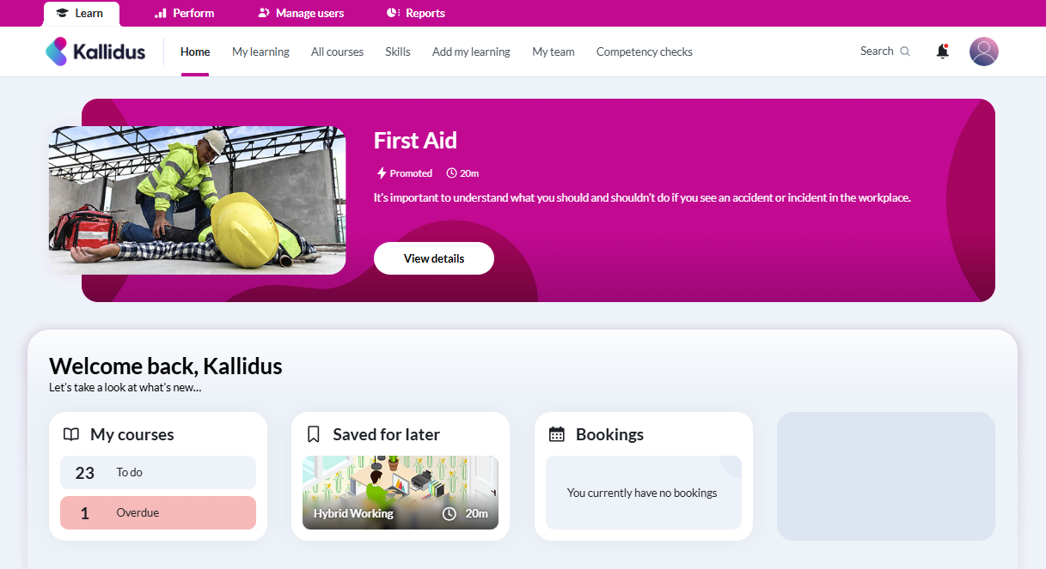
Learn: User Guide
Contents:
Accessing Learn
My Details
Dashboard and Navigation
Find Learning
Course information
Book an instructor led event
Add external learning and reflections
FAQ & Contacts

Slide 3
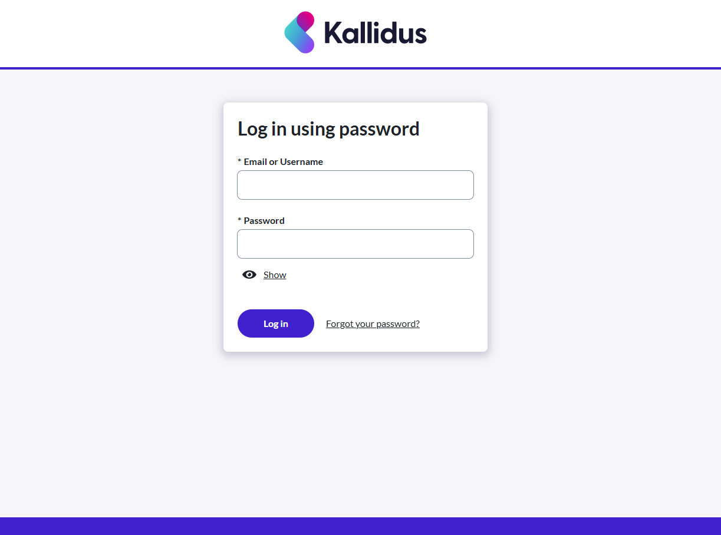
Accessing Learn
For access via single sign on:
To access Learn, navigate to X and select icon Y
If you are logged onto our network this will take you straight into the system to access your learning.
If you have any issues with access, please contact XXX
For access with username and password:
To access Learn, navigate to X and select icon Y
You will be prompted to enter the username and password that you have been supplied via email.
When you first attempt to log in, you will be asked to reset your password. Please ensure that you follow our cyber security guidelines when choosing your password.
You will also find a ‘Forgot your password?’ link here if you need to reset your password.
If you have any issues with access, please contact XXX

Slide 4
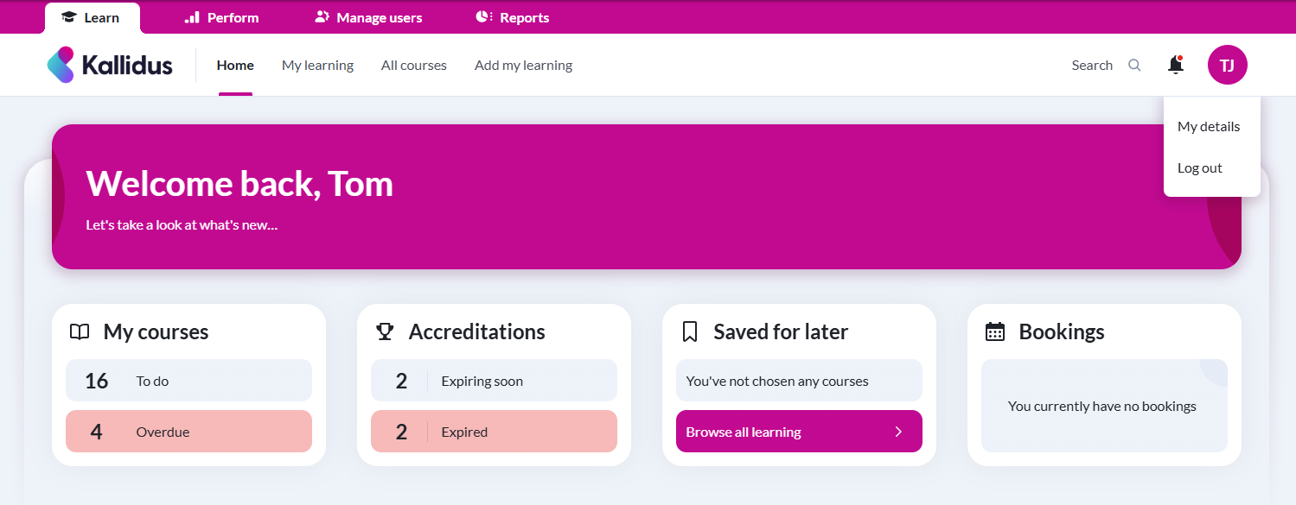
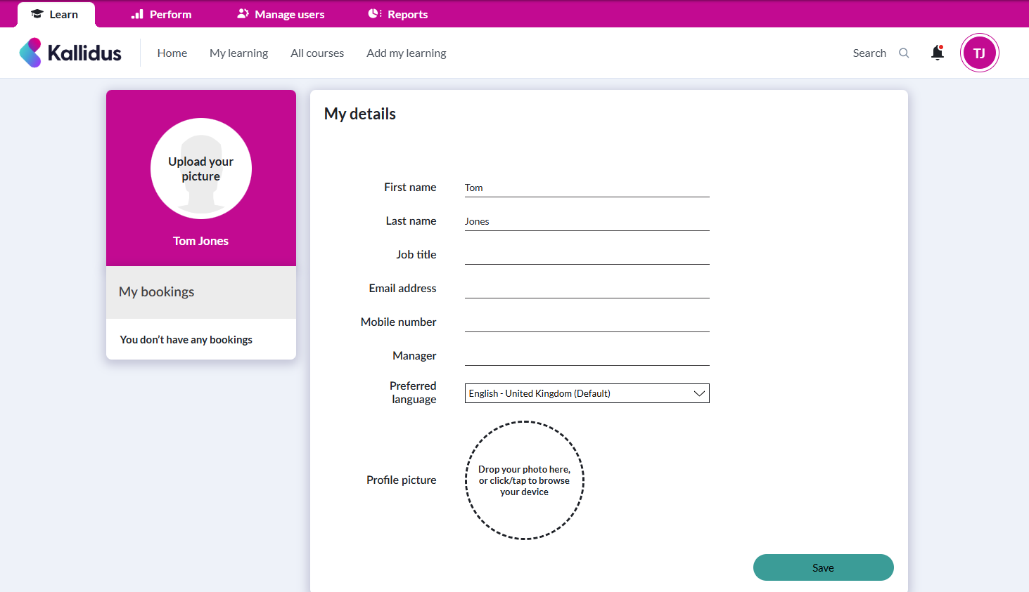
My Details
Access your details by clicking on your initials in the top right of the screen and selecting ‘My details’.
Here you can view your profile information. If any of these details are incorrect, please contact XXX.
You can also upload a profile picture here.
The image will need to be square.

Slide 5
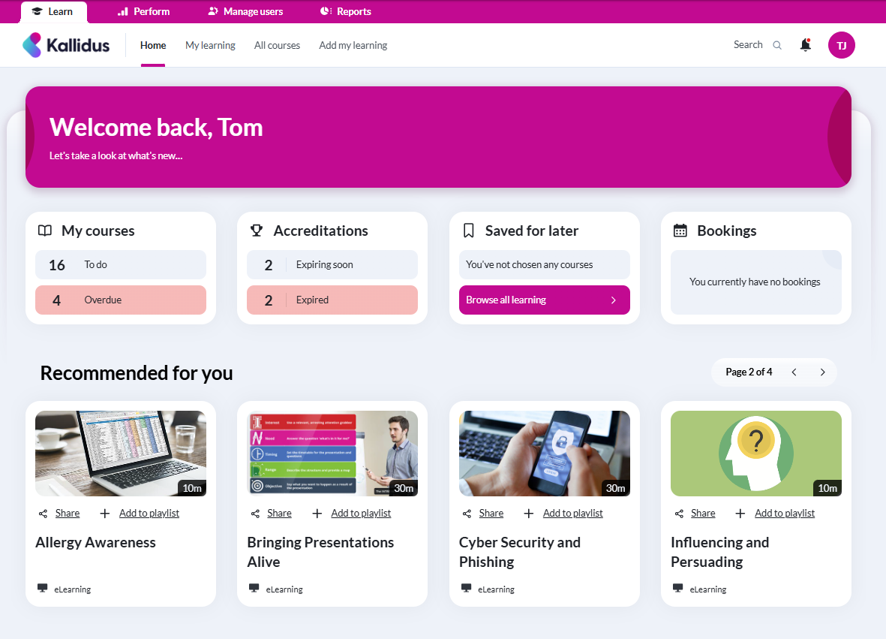
Dashboard and Navigation
There is a search bar here where you can find learning based on keywords and topics (for more advanced search options see the ‘Find Learning’ section of this guide).
On the home page you will see your learning dashboard. This displays an overview of the learning you need to complete, learning you have completed and the approximate amount of time you have spent so far.
From this menu, you can access
‘My learning’
(courses assigned to you, courses you have chosen, and courses you have completed),
‘All courses’
(all courses available to you) and
‘Add my learning’
(to record external learning).
You will receive notifications via email and they will also be available to view and dismiss by selecting the bell icon.
If you have booked any instructor led events, you will see details of your next event here.
In this section, you’ll be able to see optional courses which have been recommended to you by other users or their star rating.

Slide 6
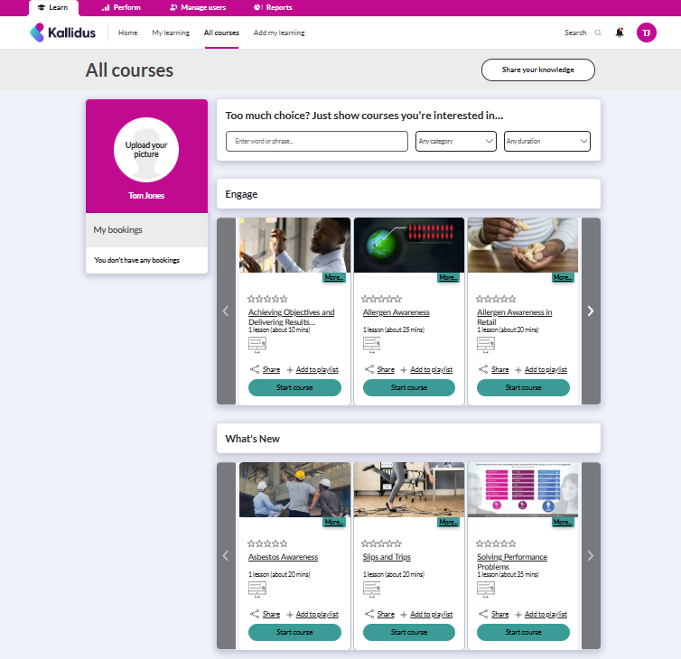
Find Learning
All courses will display catalogues of learning resources available to you.
Scroll through the catalogue contents or use the search functions to filter to specific topics.
Wherever you are in the system you will see this search bar. Use keywords and phrases to search for content on topics that you would like to learn about.
You will also find a more advanced search here. Filter the catalogues by entering key words or phrases, filter for different categories, or if you have limited time available you can search by duration.

Slide 7
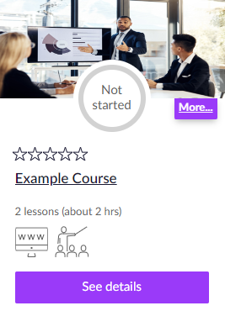
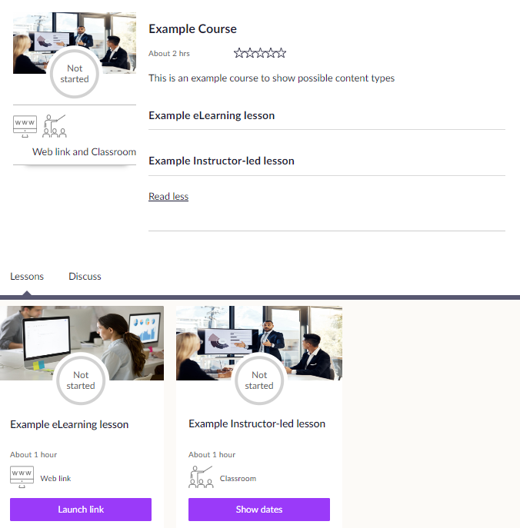
Course information
Find out about a course by clicking on the title or ‘See details’ to view a description and more information about the course.
You will see the lessons that are included in the course and icons indicating whether they are eLearning, classroom, weblink or document lessons.

Slide 8
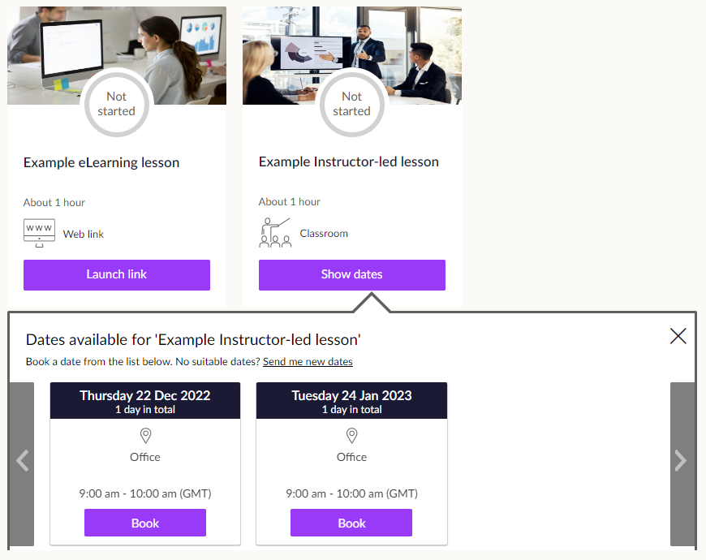
Delete the instructions as appropriate for your workflow(s) and ensure your screenshot reflects your workflow(s)
Book an instructor led event
No Approval required:
Click ‘Show Dates’ to see available event dates and times. Find an event you are able to attend and click ‘Book’ to secure your place on the event. You will receive a notification confirming your booking. If an event is fully booked, you may be offered the option to add your name to a waitlist in case a space becomes available on that date.
Course level approval required:
Click ‘Ask for Approval’. Your approver will be notified of your request to attend the course and you will receive notifications to confirm whether your request has been approved. Once approved you will be able to view and select a date to attend.
Event level approval required:
Click ‘Show Dates’ to see available event dates and times.
Find an event you are able to attend and click ‘Ask for Approval’. Your approver will be notified of your request and you will receive notifications to confirm whether your request has been approved. Once approved you will be automatically booked onto your chosen event and will receive a notification of your booking.
If no dates are currently available, click ‘Send me new dates’. This will add you to a list to be notified when new dates are made available.

Slide 9
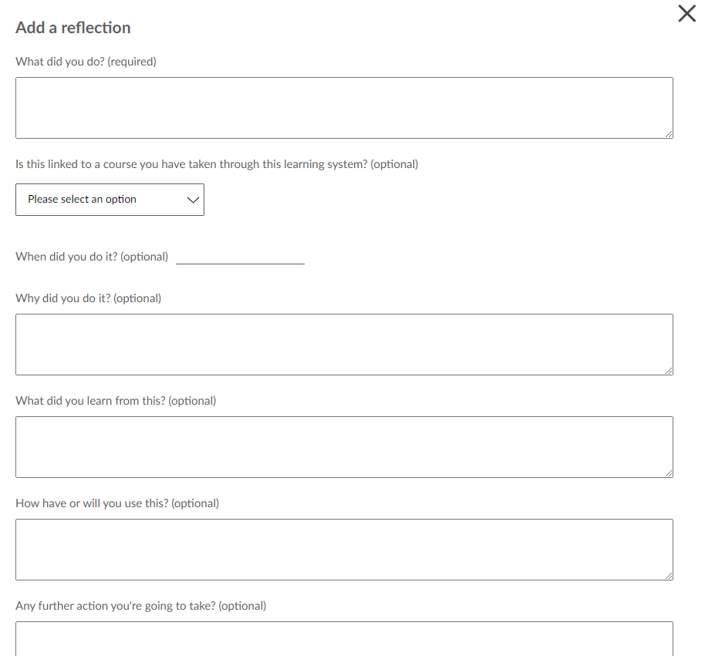
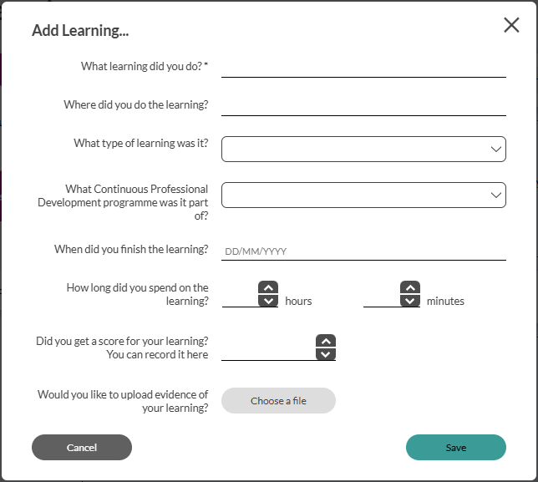
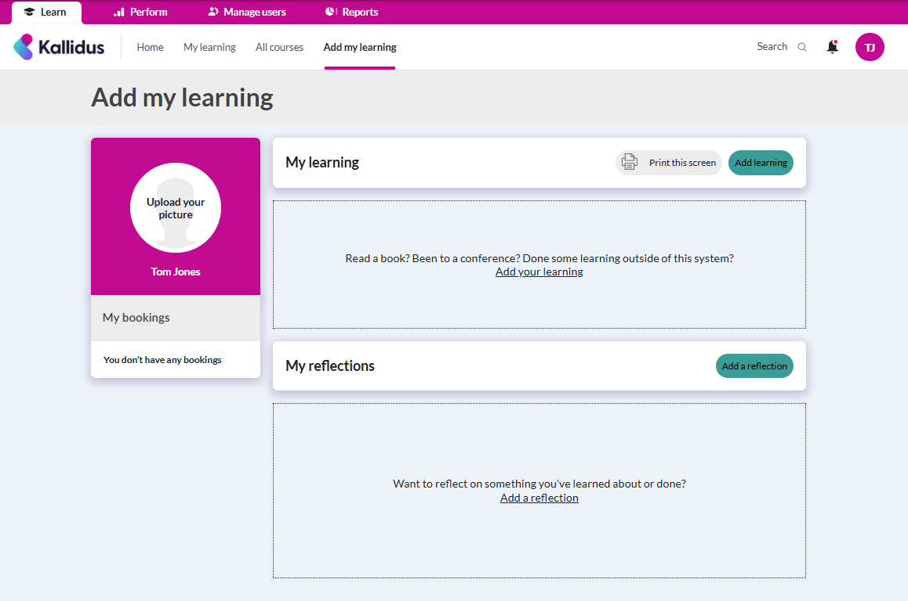
Add My Learning & Reflections
You can record reflections about your learning or details of learning that you have completed externally in the ‘Add My Learning’ section

Slide 10
FAQ & Contacts
Question | Answer | Question | Answer
How do I arrange an account for my New Starter? |  | How do contractors access the LMS?
I have forgotten my password, what should I do? |  | Where are LMS emails/reminders sent?
How is my dashboard populated? |  | For what purposes are my personal data processed and stored?
What happens to my learning when I change job role? |  | What happens if I/a member of my team is on Long Term Sickness?
I have taken an eLearning course and it is not showing as complete/passed, who should I contact? |  | My team members are not appearing on my dashboard, who should I contact?
I am experiencing issues with Single Sign On, who should I contact? |  | I am experiencing issues with mu username/password, who should I contact?
I am experiencing issues with a page not loading, who should I contact? |  | I am experiencing issues with the system being slow, who should I contact?
How do I access the LMS from home? |  | Who can view my training history?
How do I add learning to my dashboard? |  | Can I be exempt from any mandatory training?
How do I remove learning from my dashboard? |  | I cannot launch an eLearning course, who should I contact?
For any queries not listed above please contact:

