Slide 1

Learn
Manager user guide model

Slide 2

Personalising this guide for your organisation
This user guide is intended as a model for Kallidus customers to update according to their own internal processes. Please ensure that you read through it thoroughly and edit to suit your organisation and processes. The layout and design of this document has been deliberately kept plain and simple so that you are able to add your own branding and preferred style.
Consider your audience – would more detailed or simplified instructions work better for them?
Edit the language to suit your company tone of voice
Change the term ‘Learn’ to the system name you will be using internally
Add your company logo and use your company branding, colours or standard layouts
Replace screenshots with imagery from your own system so that the branding and functions displayed match what your managers will see. You may want to use a test user account with manager access for this.

Slide 3
Personalising this guide for your organisation
This user guide is intended as a model for Kallidus customers to update according to their own internal processes. Please ensure that you read through it thoroughly and edit to suit your organisation and processes. The layout and design of this document has been deliberately kept plain and simple so that you are able to add your own branding and preferred style.
Delete functions or features that you are not planning to use from the contents list and appropriate slides
The FAQ/Contacts slide at the end of this document will need to be updated according to your organisational processes
When you are happy with the wording and layout of the guide, save it as a PDF to send out to your managers as part of your communications.
Please remember to remove these instructional slides before saving as PDF and providing to your users

Slide 4
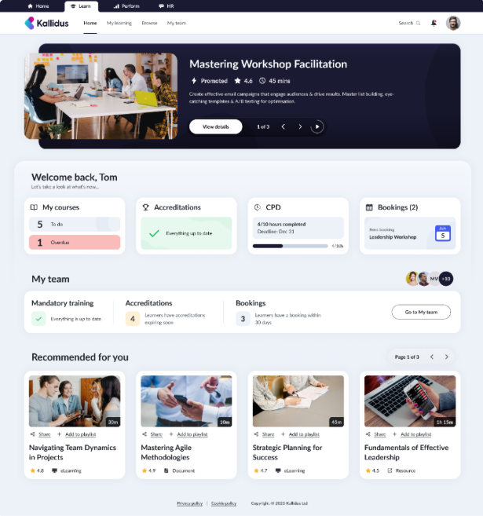
Learn: Manager Guide
Contents:
Home – My Team dashboard
My Team – Functions
  Team summary
  Mandatory training
  Instructor-led training
  Top learners
  Competency checks
Senior manager view
Sharing courses as mandatory for your direct reports
FAQ & Contacts

Slide 5
Home – My Team Dashboard
On the home page of Learn you will find the My team dashboard.
This dashboard shows a brief overview of your team’s current status and progress.
Quickly access more detail or take action by selecting the buttons here to take you to the full set of My team functions.

Slide 6
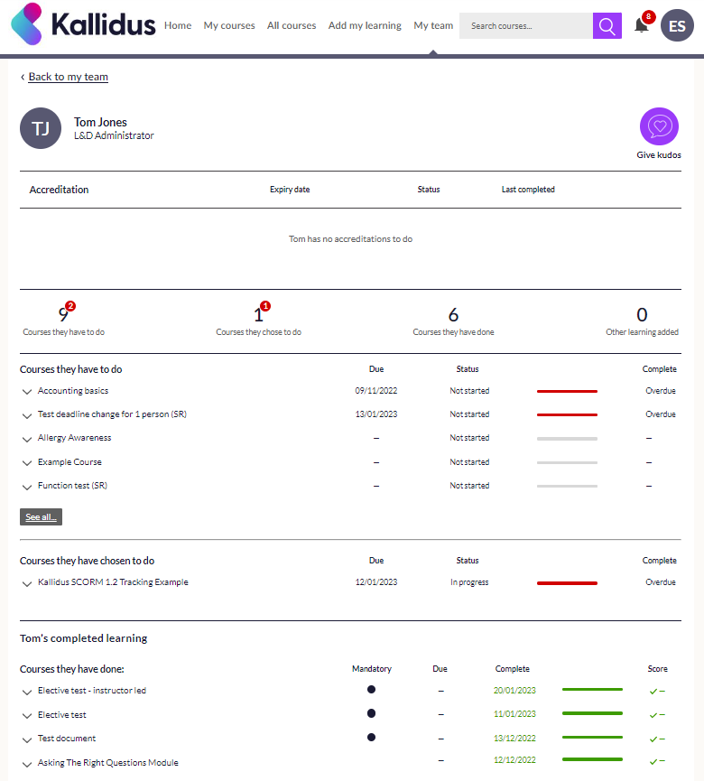
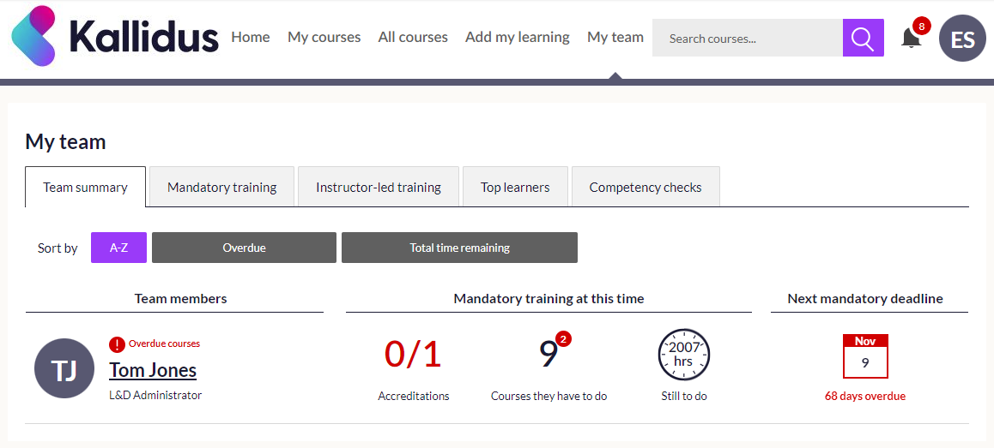
My Team functions: Team Summary
Access a full summary of your team members’ learning by selecting My team from the ribbon along the top of any screen in Learn.
Here you will see an overview of each of your team members’ mandatory learning status.
Select the name of a team member to see more detailed information and to Give Kudos to learners that are doing well.

Slide 7
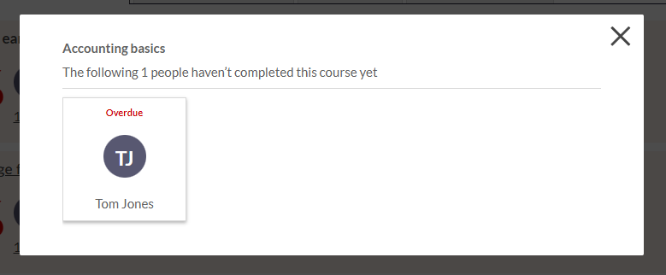
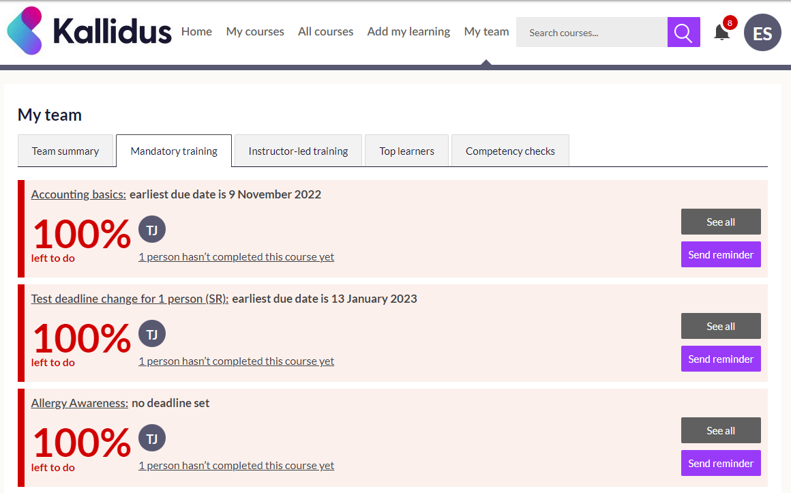
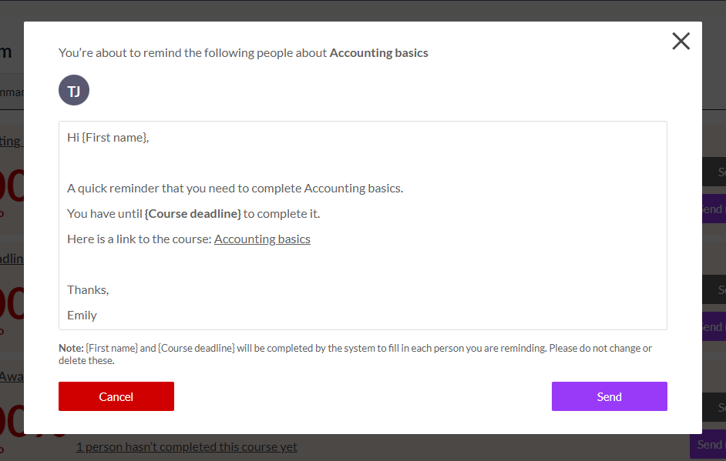
My Team functions: Mandatory Training
In the Mandatory training tab, you will find all courses that have been assigned as mandatory for your team with a quick view of how close your team are to full compliance and which team members have not yet completed the course.
Use the See all and Send reminder buttons to keep track of anything outstanding and to remind your team to complete these courses.

Slide 8
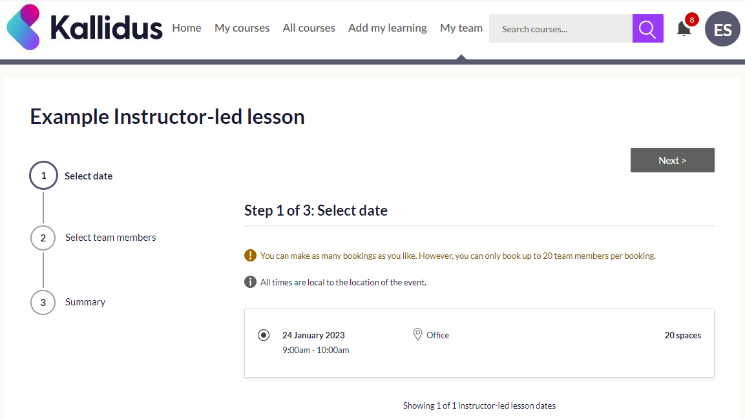
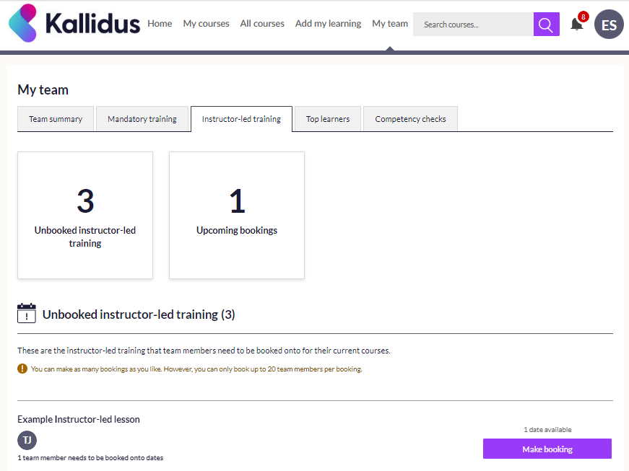
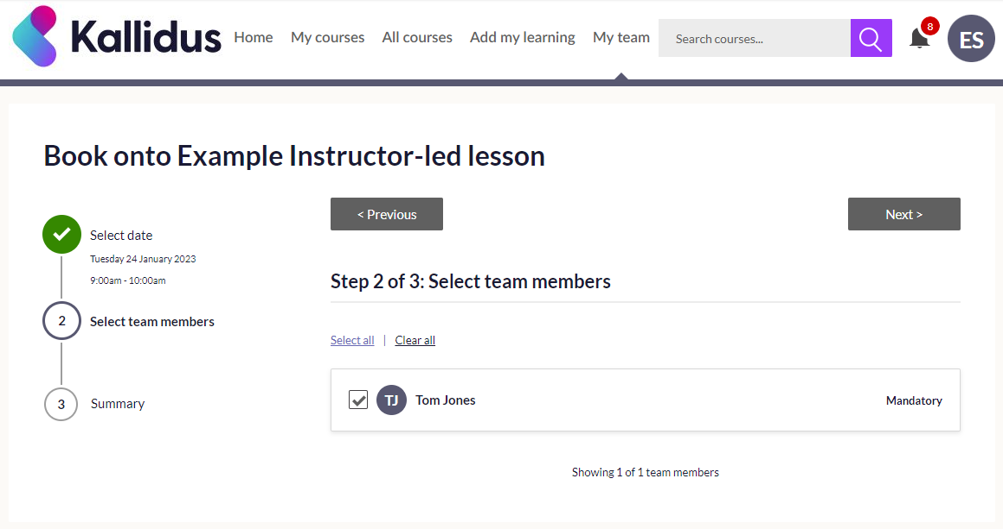
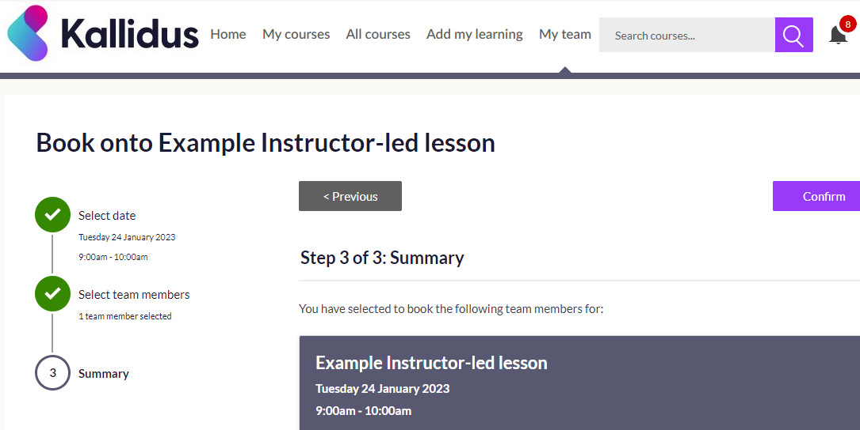
My Team functions: Instructor-led Training
The Instructor-led training tab allows you to view any upcoming event bookings for your team as well as mandatory courses for which they do not currently have a booking.
You can make a booking on behalf of your team member here by selecting the Make booking button and following the simple 3-step process.

Slide 9
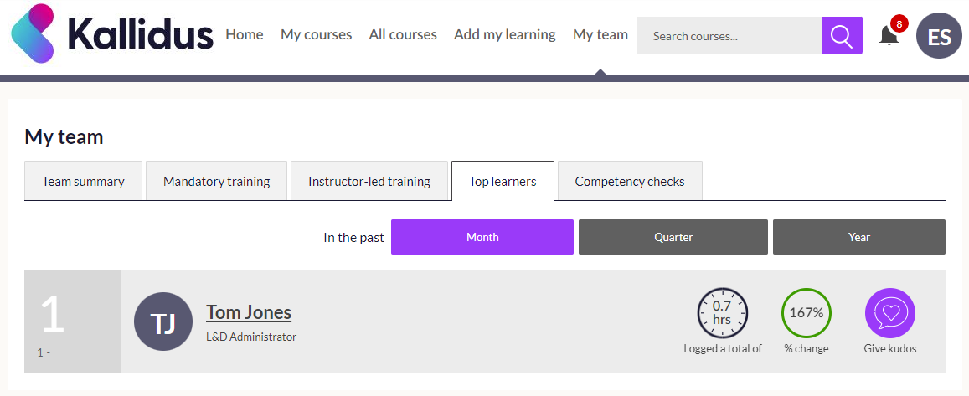
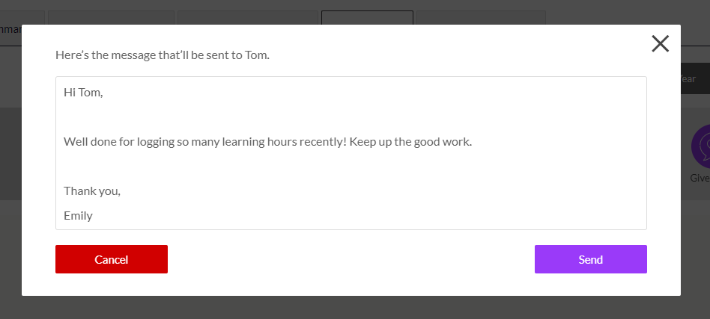
My Team functions: Top Learners
In the Top learners tab, you will find details of the top learners in your team. This is based on amount of time spent learning and how much progress they have made. You can expand the time frame you are looking at from the past month to the past quarter or year.
Use the easy access Give kudos button here to send a message to your top learners and praise them for their hard work.
There is a standard message available which can be edited to give a personal touch.

Slide 10
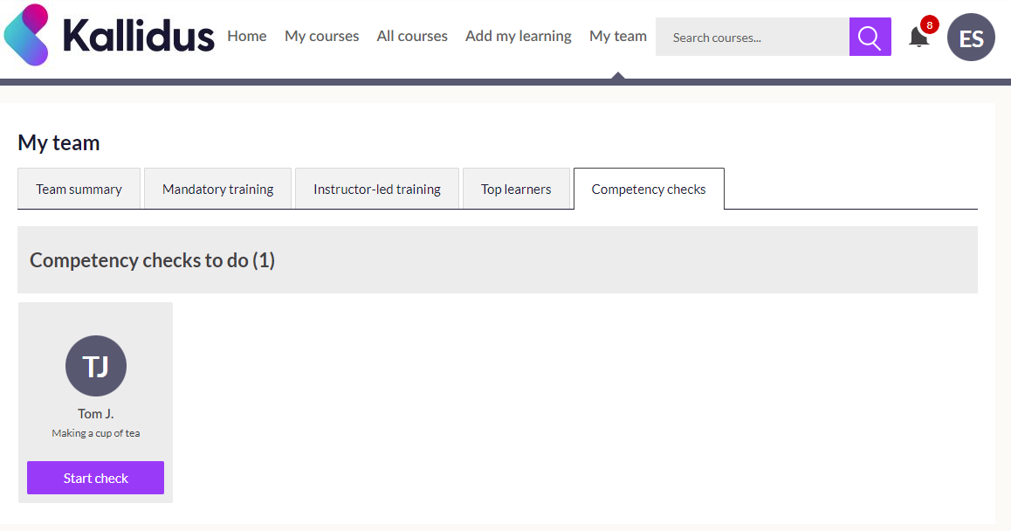
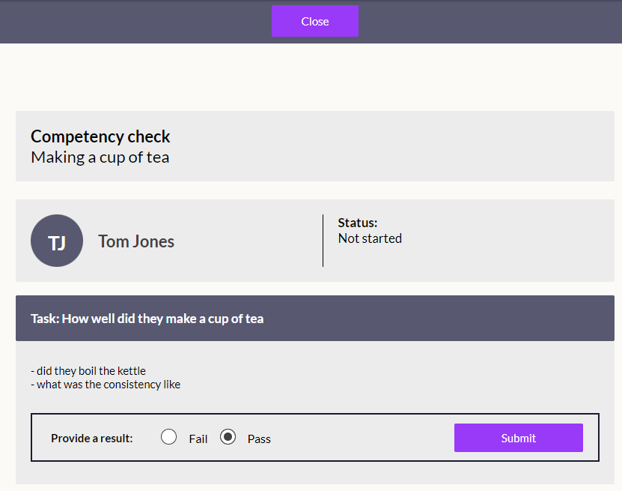
My Team functions: Competency Checks
A competency check is an assessment of whether a team member is able to complete a specified task competently, and within our company guidelines. If a competency check is required, you can mark the result as a pass or fail in the Competency checks tab once you have observed the task being carried out.
Please ensure that you read the guidelines available before deciding whether your team member has passed or failed.

Slide 11
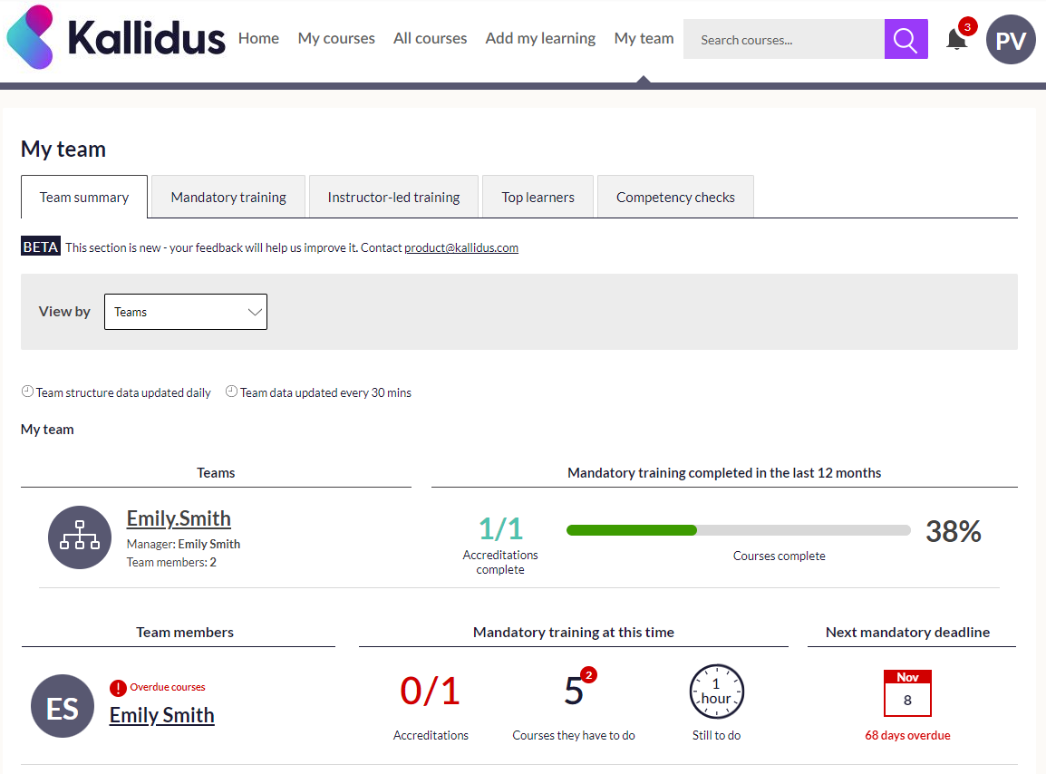
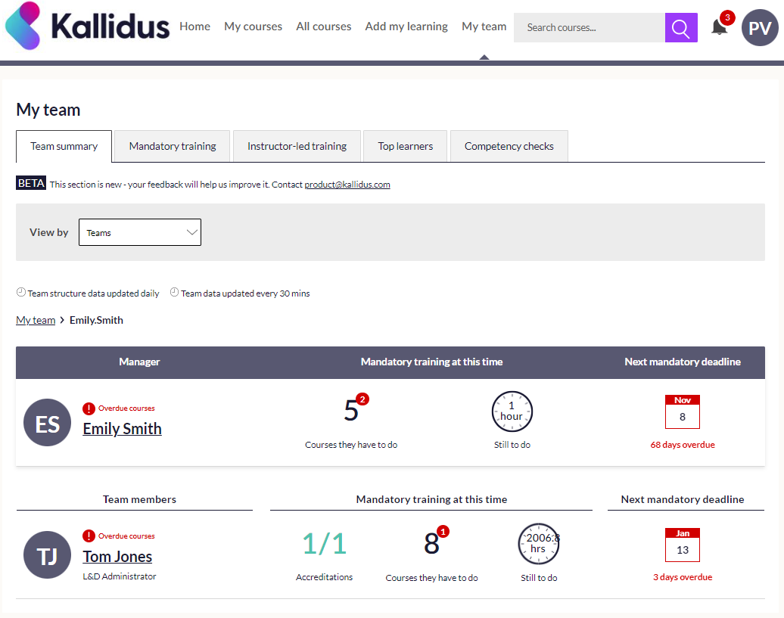
Senior Manager View
If someone in your team has their own direct reports, you can look at a summary of their learning progress in the Team summary tab by changing the View by drop down from Direct reports to Teams.
From here you can drill down into any teams that you are indirectly responsible for via managers in your own team.
As you move down the hierarchy, the breadcrumb shown below can help you keep track of which team you are looking at.

Slide 12
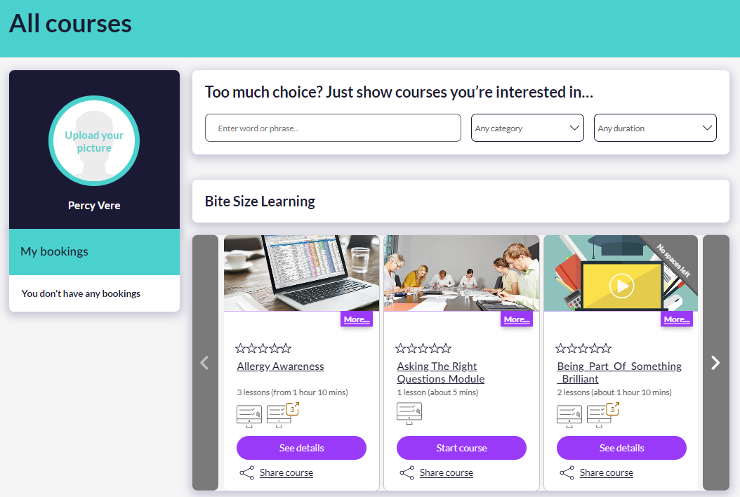
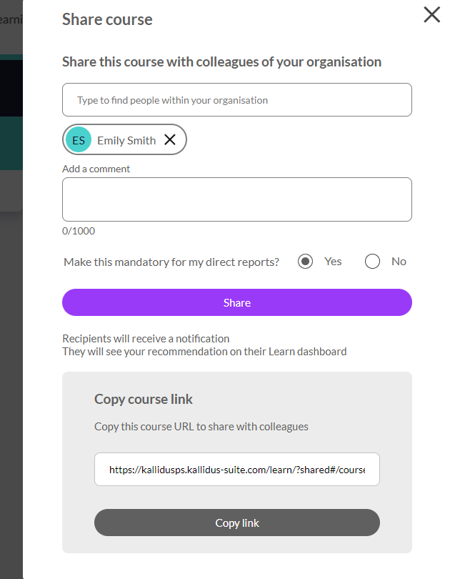
Sharing courses as mandatory for your direct reports
As a manager, you are able to share courses to your team members as mandatory learning.
Find the course you want them to complete and select Share course.
Search for the team members you want to share the course with and select Yes under the Make this mandatory for my direct reports?
Click Share.
Your direct line reports will receive a standard course notification and any others will receive a recommendation notification.
Note: Sharing as mandatory will only work for your DIRECT REPORTS.
You are able to share with indirect reports and other colleagues at the same time, but these will only be delivered as recommendations.
Sharing as mandatory with direct reports will add the course to their Courses I have to do dashboard.
For others that you share with, a notification will be sent, including any comments you have added and the course will appear under Recommended courses on their Home screen.

Slide 13
FAQ & Contacts
Question | Answer | Question | Answer
How do I arrange an account for my New Starter? |  | How do contractors access the LMS?
My team members are not appearing on my dashboard, who should I contact? |  | Where are LMS emails/reminders sent?
The members of my team are not correct, who should I contact? |  | For what purposes is personal data processed and stored?
How are my team’s learning requirements populated? |  | What happens if a member of my team is on Long Term Sickness?
What happens to my team member’s learning when they change job role? |  | I am experiencing issues with the system being slow, who should I contact?
My team member has taken an eLearning course and it is not showing as complete/passed, who should I contact? |  | Can my team members be exempt from any mandatory training?
My team member is experiencing issues with Single Sign On, who should I contact? |  | How does my team access the LMS from home?
For any queries not listed above please contact:

